Slide 1










SAP @ Eaton Landscape
Key Unity Applications
ERP Usage
SAP ECC 6.0 EhP 7 (ERP)
SAP BW (Business Warehouse Reporting)
SAP GTS (Global Trade)
SAP EHSM (Global Environmental Health & Safety
Users: ~20k
Revenue: ~$10b USD
Sales Orders Per Year: 3m!
Production Orders Per Year: 4.5m!
Plants: 320
Countries: 47
Languages: 20
SAP Unity
System Maintenance
Annual patching during Q4 and Q1 to keep the application supported and compliant
Twice monthly release windows for changes to production environment

Slide 2
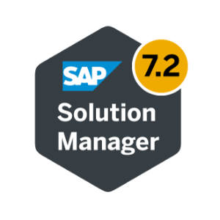

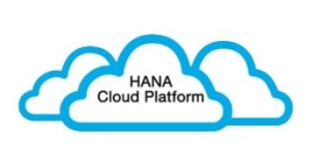





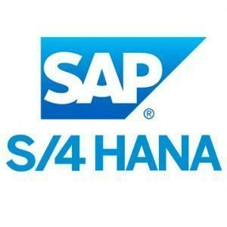
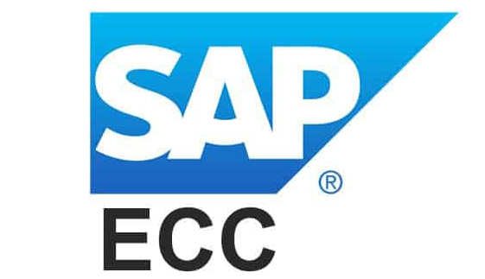

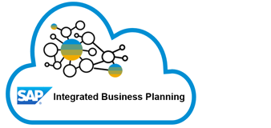



SAP @ Eaton Landscape
PROCOE
APPCOE
ADMCOE
BICOE
AGSCOE

Slide 3


Presentation / UX
Portal
Ionic
Polymer
JavaScript / HTML(5)
Angular
JQuery
SAP GUI
Adobe Experience Manager
Mobile
SAP Fiori
SAP Personas
Node.js
Webcenter Content Managemt
SAP Portal
Collaboration / Productivity
MS Sharepoint
MS Yammer
MS Office 365
MS Teams
Customer Experience
Order Management
Product Portfolio Management
Production
Supply Chain Management
Case
eCommerce
SAP
SOA (Fusion)
Global Vista
Product Lifecycle Management
SAP
MAPCIS
SIOP
Oracle EBS
Vista
Enovia
SAP PLM
Oracle EBS
DMM
Demantra
SAP IBP
C360
Order Center
MFGPro
CAPPE
Winchill
MFGPro
Demand Solutions
Forecast Pro
Salesforce
Euclid
Digital Asset
Biovia
Finance Management
Procurement
Configure, Price, and Quote
Thingworx
Webcenter
Project Portfolio Mngmnt
Financials
Ariba
EPIC
Environmental, Health, & Safety
ProPM (Clarity)
Tenrox
Unify (R12)
Quantum
Supplier Viz
SAP
Configure
Price
SAP cFolders
Others…
Oracle EPM
EF3
Oracle EBS
Others…
Incident Mngmt
Design
SAP
Dolphin PTS
Sourcing
Bidman
Oracle CPQ
MESH
SAP Portal
Power BI
GetPaid
Taulia
Ariba
SAP
Oracle Configrtr
Vistex
EH&S
SAP BW
AutoCAD
Draftsight
Markview
Encore
Conga CLM
Others…
SAP VC
Bidman
Prod. Comp.
CATIA
Solidworks
Tax Managment
Transportation
Design Automtn
SC Pricer
Prod. Comp.
Inventor
Others…
Vertex
Prem. Frght.
3PL
CSE
SAP
Analytics
ECAD
SAF-T
TAXi
CASS
Flag/Clippership
MCD
Oracle EBS
Altium
Cadence
Others…
Worldship
Others…
Power Source
Zilliant
OBIEE
SAP BW
PADS
Project Portfolio Mngmnt
Others…
Others…
CERP
RT-ODS
Simulation
Oracle EBS
SAP
Global Trade
Oracle BDD
Oracle BAW
Ansys
IOT & Supply Chain
SAP GTS
Amberroad
Quote
SAP HANA
Workforce Engagement
MES
Vastera/Annex
Others…
Visualztn
WMS
Oracle CPQ
SAP
Power BI
Qlikview
SuccesFactors
KRONOS
Thingworx
Azure
Sterling WMS
ISI Exeter
Self Serv
Oracle HRMS
APEX
IPC
Others…
Power BI
RIMS/AIM
Others…
Service Management
Plant Maintenance
Payroll
Taleo
Quality Management & Compliance
Spend Management
Salesforce
SAP
Faciliworx
SOA (Fusion)
Maximo
Others…
WISPER
GAGEtrak
Ariba
SAP SRM
Oracle EBS
SAP C4S
Oracle EAM
Others…
SAP QM
Others…
Others…
ERP
SAP
Oracle EBS
MFGPro
MAPICS
Glovia
WorldLinx
PRMS
BAAN
BPCS
eBiz
Middleware
Monitoring
SOA (Fusion)
SAP PI
SAP CPI
TIBCO
MQ
Control-M AFT
ATP
SAP SolMan
Oracle OEM
SiteScope
Credit Card
EDI
KM
Label/Marking
Job Schdlng
Paymetric
Sterling Integrator
PCM
SAP SolMan
Loftware
Bartender
Others…
Control-M
Technology Platform
Big Data
Access Management
Automation
Data Management / CDC
Commercial IoT
Oracle Appliance
Cloudera
SAP GRC
CyberArk
Automate Anywhere
Ignio
Info Steward
SAP SLT
Azure
Oracle
Oracle BDD
Others…
OIM / OAM
OKTA
Worksoft
Others…
Oracle Golden Gate
AWS
Others…
Database
ETL
MDG
Oracle
HANA
MS SQL Server
ADABAS
DB2
Progress
Informatica
SAP Data Services
PDH
TPH
Legend
Cloud
Not Deployed
Strategic
Out-of-Support
Sunset Candidate
PROCOE Owned
L0 - Capability
L1 - Capability
Supporting
Notes:
Notes:
Developed based off an original slide provided by Jon from the Hydraulics project
Move ERP into the technology platform section
Work with the teams to determine the proper categories and understand where to include Others… system / application list
In platform layer switch IoT to Commercial IoT
Application and Technology platform slide
Look at a different way to represent ERP complexity
ERP’s touch many of the represented level 0 and applications
Need to show the complex environment
How can it be better visualized?
Lower right
IoT/I4.0 – rename to Commercial IoT for clarity
Add OTHERS block to Big Data
How can we represent a target application in each area
Add icon to app in current slide?
Add a to be slide in the same format?
Some color coding of applications needs to be fine tuned. Team to get feedback from their SLT member and adjust accordingly

Slide 4



SAP @ Eaton
ERP Revenue is expected to increase from ~50% to 90% over the next 5 years as the deployment of SAP as the strategic ERP platform for ES, Aerospace and eMobility continues.
Other strategic non-ERP SAP tools for SuccessFactors, Concur, IBP and Ariba continue to standardize corporate functions
Influencing Factors
ES Oracle to SAP program
Aerospace to SAP program
Legacy ERP migration to SAP
Acquisitions moving to SAP
ES Americas to SAP program
Aerospace to SAP program
Acquisitions moving to SAP
ES Oracle to SAP program
Legacy SAP to Unity migration
Aerospace to SAP Program
Acquisition moving to SAP
*2026 revenue figures are based on 2020 Revenue and completion of the influencing factors

Slide 5
SAP ERP instance strategy Recommendation for LOB Model
Recommendation: Line of Business Global instance
Electrical Sector can go onto Un1ty ECC instance
Aerospace can go onto separate S/4 instance
Key supporting initiatives
Governance
Regression testing
Automated test scripts
Change Control Tools to helps manage sequencing and interdependency
Business Process Standardization
Process Management (Solution Manager) to reduce knowledge gaps and drive standardization
Master data governance
Centralized financial reporting and harmonized enterprise data warehouse
Performance
Hardware scalability
Archiving
Active Monitoring
Code Review tools
Justification
Hardware scalability is not a major issue
Instance ownership, agility and business fit
Recommendation
1. Single Global Instance by Line of Business
Single DEV
PRD
2. Single code base / Regional Business Systems
Single DEV
PRD
PRD
3. Single code base + different Business Systems
Common DEV
L-DEV 1
PRD 1
L-DEV 2
PRD 2
4. Different code base and Business Systems
DEV 1
PRD 1
DEV 2
PRD 2

Slide 6
SAP Next Generation LOB Instance Strategy
A single SAP instance per logical business unit driving ownership into the business...
PROS
CONS
Preserves tightly integrated end-to-end processes within a Line of Business without the need to rationalize and force a one-size-fits-all model.
Harmonization of business processes and the creation of a LOB Operating Model leads to high business and IT benefits, speed to deploy, and reduced deployment costs – increasing business “ownership” of ERP
A shared “enterprise layer of tools” (Central Finance, MDG) allow shared services and consolidated reporting without a true single instance.
Ease of mergers, acquisition and divestitures due to data segregation and business realignment within SAP ERP landscape leveraging
Reduced impact of any down-time including planned upgrades, maintenance, carve-outs, etc.
Cost of SAP systems may increase with shared tools such as Central Finance, Master Data Governance and supporting multiple connections to non-SAP sanctioned applications.
Increased level of integration and landscape complexity will require robust integration standards
Identify, empower and enable Global and Regional BPOs
Definition of harmonized processes per business unit
Establish Master Data Governance organization per business unit
Initiate discovery phase for model company per business unit
Driving a LOB Operating Model and a transition from an “IT-owned” to “business-owned” ERP

Slide 7
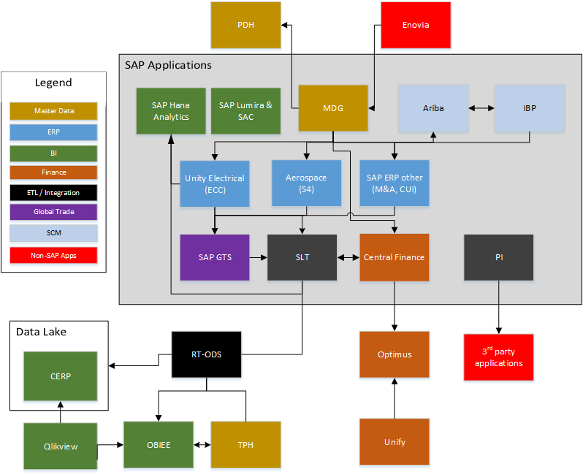
SAP Next Generation Instance Strategy
LOB instances enable shared services while supporting unique business strategies
Preparing for multiple SAP Instances
Reduced risk on downtime.
Align business processes to industry best practices (no need to “force-fit”).
Enables simplified system ownership.
Provides greater opportunity for agility by division
Scalable eco-system does not require a digital core to be merged (e.g. M&A and divestitures activities).
A tightly integrated system landscape supporting a digital core per logical business unit

Slide 8
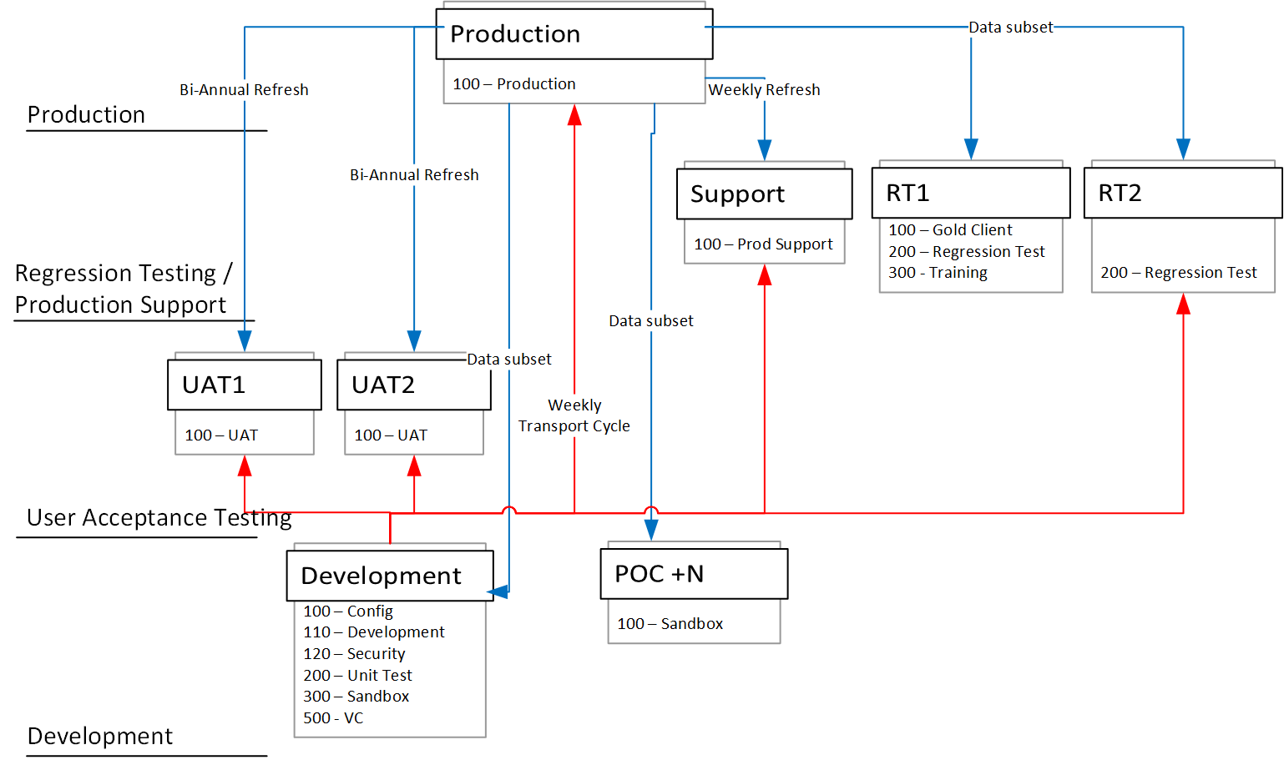
SAP Next Generation Instance Strategy
SAP System Client and System strategy
Flexibility and Governance
Additional dedicated training system
Additional regression test instances with stages data
Sandbox for solution and demo of new functionality
Enables simplified system ownership.
Improved data refresh capabilities for moving prod data to dev, QAS, training, regression test and sandboxes

Slide 9








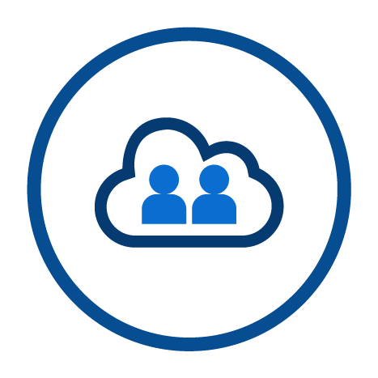
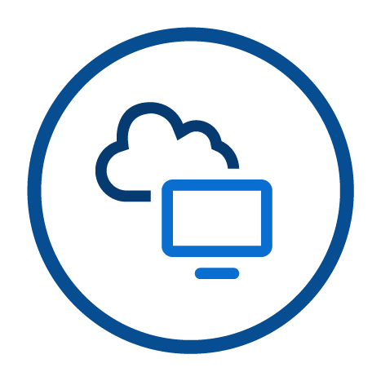


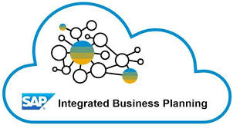
High-Level As-Is Landscape
Unify
DMM
Vastera
Bidman
C360
OIM
HRMS
Order Center
Supplier Vis
PDH
Conga CLM
INTERNET
Customers / Suppliers / 3PL
Firewall
WISPER
Limited usage primary access through GUI
Joe Portal
CPQ
Secure tunnel
SOA
Sterling WMS
FEKOR
Secure tunnel
OAM
Worldship/Clippership
Service Cloud
CASS
Customers / Suppliers / 3PL
Laser Etching
Oracle R11
Controls
Access and
SOD Audit
Reporting
For all
On Prem
SAP Systems
And
HANA DBs
DBA, BASIS, Privileged Access (investigate usage for application level privileged access for on-premise Netweaver apps; likely will need to use IAM for cloud application privileged access)
ALM and monitoring for all on-prem SAP systems, currently implementing Solution Documentation; LaMA
Portal
RPA
EDI
Sterling Integrator
GRC
CyberArk
SolMan
Provides SSO access to multiple SAP systems, access to BOBJ reporting and EHSM reporting (MESH Prism); may sunset in the future; Engineer change approval flows are also in the Portal; C3 reporting will be sunset this year;
AutoMate
Anywhere
Limited to a single site; being replaced with a new Solution in 2021/22
Taulia
Gateway
SAPUI5 App
HTTP
Paymetric
Secure tunnel
Ignio
FES6
AFIP
SAP PI
OData API
Secure tunnel
RFC
RFC
Product Compliance Data
trust
Cloud connector
ECC EHP7
RFC
Dolphin PBS
Connectivity
Personas
SAP NFe
FTP
Secure tunnel
RFC
Identity Auth.
Enterprise Management:
Finance & Controlling
Manufacturing
Production Planning
Project Systems
Sales / Logistics
Warehouse Management
RFC
SAP DS 4.2
Ariba CIG
Sourcing & Procurement
Quality Management
Product Lifecycle Management
Cideon
Enovia
trust
trust
CPI DS
Automated Testing
RFC
Loftware
WorkSoft
&
Load
Runner
EHSM Add-on
Incident Management
Product Compliance
WinShuttle
RFC
Vistex
Govt/Broker
trust
eInvoicing
Onapsis
RFC
SEAL
Trade data from non-SAP ERP systems
RFC
Vertex
BigByte MRP Monitor / Advanced MD04
SAP cFolders
Initial project in progress for EMEA region, using time series forecasting
Dolphin PTS Add-on
LCR Dixon
RFC
Ariba CIG Add-on
Fire-fighter
ITS
HTTP
TAXI
EF3
Secure tunnel
IBP Add-on
Job Scheduling / AFT
RFC
Control-M
Optimus
Quantum
eInvoicing / SAF-T Add-ons etc.
Demantra
CERP
Atlas (German Exports)
Qlikview / PowerBI
Seeburger
RFC
GTS
SLT
RT-ODS
OBIEE
May use OKTA with Fiori applications to allow
External access to SAP Fiori launchpads; currently VPN connections on devices are used
BW on HANA
Data Services Agent
Onapsis
HANA Enterprise / XSA
May be able to replace with CyberArk
Concerns exist with the PowerBI security model (does not align with SAP user access) and indirect access licensing issues when using SAP data
Limited Crystal Reports and Broadcasting/may sunset in future
RFC
SSO
BI Java
Current 7.31 on Oracle, March 21 Go-live
BEx
SAP BOBJ 4.0SP 12
Adobe DS
Notes:
High-Level Current State Landscape

Slide 10
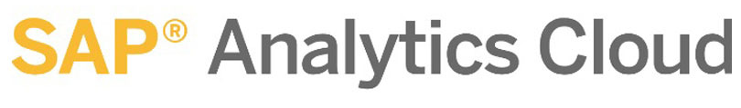
High-Level Aero
Future State Vision
INTERNET
Unify
Thingworx
DMM
Vastera
Bidman
C360
OIM
Conga CLM
Order Center
TPH
EPAS
SupplierVis
PDH
May be able to remove by using PPAP/new QM functionality in S4; SAP QM is sanctioned by quality board
Firewall
WISPER
Joe Portal
CPQ
Salesforce
Secure tunnel
SOA
Central GFSS system to manage/connect all SAP ERP financial processes and GFSS controlled master data
May be able to remove by using Ariba Supplier Collaboration Portal
SSO connections and integration to Fiori launchpads
CASS
Customers / Suppliers / 3PL
EDI
Sterling Integrator
Controls
Access and
SOD Audit
Reporting
For all
On Prem
SAP Systems
And
HANA DBs
DBA, BASIS, Privileged Access (investigate usage for application level privileged access for on-premise Netweaver apps; likely will need to use IAM for cloud application privileged access)
ALM and monitoring for all SAP systems (including cloud); Knowledge Management for process and FRICE documentation, change management; LaMa
Provides SSO access to multiple SAP systems, access to BOBJ reporting and EHSM reporting (MESH Prism); Engineer change approval flows are also in the Portal; C3 reporting will be sunset this year;
RPA
Central Finance
SAPUI5 App
GRC
CyberArk
SolMan
Portal
AutoMate
Anywhere
Need clarification on how APIGEE fits in the landscape/use cases
APIGEE
SSO 3.0
Vertex Q Series
Taulia
SAP Gateway*
OData API
Paymetric
Secure tunnel
Central Process Orchestration
Universal Journal
Central Payments / Collections
Central Credit Management
Master Data Governance
SAP PI
Embedded Analytics
trust
SSO 3.0
SAPUI5 App
RFC
Connectivity
Personas
Gateway
SAPUI5 App
HTTP
Secure tunnel
EHSM Add-on
SAP Gateway*
OData API
trust
Enterprise Management:
Finance & Controlling
Manufacturing
Production Planning
Portfolio / Project Management
Sales
FES6
OData API
Identity Auth.
Cloud connector
Sourcing & Procurement
Asset Management
Product Compliance
Quality Management
RFC
trust
Ariba CIG
Supplier Forecast/Inventory
Enovia
trust
CPI DS
Trade data from non-SAP ERP systems
Cideon
Digital assistant / context sensitive on-demand training for SAP environments;
Automated Tested
EPIC
Enable Now
WorkSoft
&
Load
Runner
IAM
Customer Management Add-on:
Service Management
Install Base Management
Knowledge Base
Extended WM:
Inbound Processing
Internal Process Control
Outbound Processing
Labor Management
Flow Optimization
RFC
Govt/Broker
eInvoicing
RFC
Loftware
trust
RFC
Ignio
Will additional Ariba realms be required for Aero S4 instances? How does that affect licensing/pricing? Currently one realm for ECC and one for Oracle.
Embedded Analytics
Onapsis
May use OKTA and Zscaler with Fiori applications to allow external access to SAP Fiori launchpads; currently VPN connections on devices are used
Ariba CIG Add-on
Fire-fighter
ITS
HTTP
TAXI
EF3
Secure tunnel
IBP Add-on
Job Scheduling / AFT
RFC
Control-M
Optimus
Quantum
eInvoicing Add-ons
Demantra
CERP
Atlas (German Exports)
Analytics Agent
Qlikview / PowerBI
Seeburger
RFC
GTS
SLT
RT-ODS
OBIEE
Candidate for HANA Replatform
BW on HANA
Opportunity to rationalize system
Onapsis
HANA Enterprise / XSA
May be able to replace with CyberArk
Concerns exist with the PowerBI security model (does not align with SAP user access) and indirect access licensing issues when using SAP data
May require resizing to handle additional load
Data Services Agent
RFC
RFC
Net New to SAP Landscape
BI Java
Monitor to understand future strategic direction
BEx
SAP BO Analysis for Office Edition
SAP Analysis for Office
Adobe DS
Notes:
Possible Future State

Slide 11
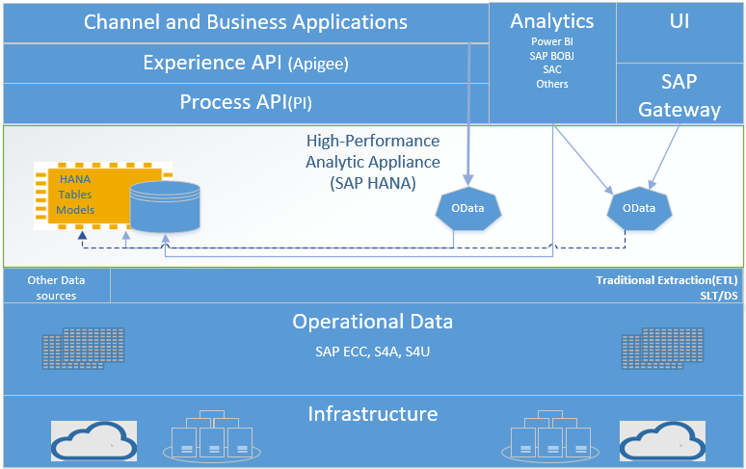
SAP Next Generation SAP Reporting and Integration
Utilizing Odata and Hana Modeling for Consolidated SAP Reporting and Integration
Reusability of Hana modeling capability to expose oData to FIORI and multiple front end Analytics tools
Consistent reuse of the SAP Hana security model
Data consolidation in the Hana DB
Realtime data replication using SLT
Notes:
This document is rough illustration of overall flow model that is related to this POC.
Presentation rendering tools (Qlikview, PowerBI, etc.) are out of scope

Slide 12
SAP Hana DB Usage Next Steps
Utilizing Hana Across the SAP Landscape and Expanding as Enterprise DB
We are licensed for 13tb of Hana DB which can be utilized by SAP and non-SAP applications
Hana Enterprise Edition Toolkit included in the licensing
Hana is the only SAP supported DB in 2027
Notes:
This document is rough illustration of overall flow model that is related to this POC.
Presentation rendering tools (Qlikview, PowerBI, etc.) are out of scope

Slide 13
IBP
Business Process Scope
Scope includes implementing SAP IBP for ES EMEA Power Distribution Components Division (PDCD) and Industrial Controls and Protection Division (ICPD)
Process groups | Processes | Description
IBP: Integrated Business Planning | Plan Supply | Perform multilevel supply planning without shortages to identify capacity bottlenecks and issues with supply.
 | Inventory optimization | Perform multi echelon inventory optimization over the entire network
 | Plan Sales & Operations (S&OP) | Collaborative alignment, driven by senior leadership, of operational and financial plans for an 18-24-month horizon. Identifies, resolves, and escalates key business issues and decisions and builds accountability into the organization.
 | Supply chain control tower | Measure and Monitor supply chain performance with alerts and metrics

Slide 14
Supply Chain Planning High-Level System Integration Diagram
Integration Highlights
Integrated Business Planning (IBP)
SAP ECC Integration:
Integration of inbound and outbound data to SAP ECC systems can be managed through standard SAP IBP Add-on
SAP IBP Add-on can also be used to extract data from ECC and integrate this to SAP BW. BW can send the data to IBP via CPI-DS in the same way as with ECC.
Demantra Integration:
Demand Forecast data integration can be managed as
Demantra→File→CPI-DS→IBP
Demantra→BW/ECC→CPI-DS→IBP
CPI-DS can handle all standard cloud integration functions to on-prem and cloud systems.
It is preferred to have single source of truth like BW to integrate with planning systems
Sales & Operations Planning
Inventory Planning
Distribution Requirements Planning
SAP ECC
Master & Transaction Data
Proposed Safety Targets for Inventory
Demand
Forecast
Master Production Scheduling
Material Requirements Planning
Data for Reports
Cloud Platform Integration
Master &
Transactional
Data,
Sales Shipment
History
MPS Planned Orders
(Master Schedule)
Inventory
Firmed Schedule
(Detailed Schedule)
Master & Transaction Data
API Integration
BW on HANA
Demantra
Demand Forecast

Slide 15
SAP Roadmap Strategic Architecture Challenges
Enterprise Roadmap Challenges
Integration
Moving to an SAP centric landscape. SAP integration technologies offer lower TCO, standardized solutions, robust and scalability integration
Common SAP UX
FIORI - SuccessFactors, ECC, IBP, Ariba, S4, BW, GTS, GRC can all use the same FIORI front end
Reporting Visualization - SAC (SAP Analytics Cloud) can be a consolidated reporting UI for ECC, BW, S4, IBP, Ariba and non-SAP applications
Master Data Governance
SAP MDG is a component of Central Finance which we will use to harmonize data across the SAP landscape
Reporting Strategy
We have a high performance real-time database (Hana and future state S4 for Aero) we need to utilize wherever possible
Data Access (ITAR, CUI, Indirect Data Access, Consistent Security Model, CTD)

